Slide 1
Fault-Tolerant Scheduling in Homogeneous Real-Time Systems

Slide 2
Acceptance Tests
An acceptance test is essentially a check of reasonableness. Most acceptance tests fall into one of the following categories:-
Timing Checks
Verification of Output
Range Checks.

Slide 3
Sensitivity:- is the probability that the acceptance test catches an erroneous output. To be more exact, it is the conditional probability that the test declares an error, given the output is erroneous.
Specificity:- conditional probability that, given that the acceptance test declares an error, it is indeed an error and not a correct output that happens to fall outside the test bounds.

Slide 4
Wrappers
A wrapper is a piece of software that encapsulates the given program when it is being executed.
We can wrap almost any level of software: examples include application software, middleware, and even an operating system kernel.
Inputs from the outside world to the wrapped entity are intercepted by the wrapper, which decides whether to pass them on or to signal an exception to the system. Similarly, outputs from the wrapped software are also filtered by the wrapper.

Slide 5
Dealing with Buffer Overflow- A wrapper can check to ensure that such overflows do not happen, for example, by checking that the buffer is large enough for the designated string to be copied.
Checking the Correctness of the Scheduler
Using Software with Known Bugs
Using a Wrapper to Check for Correct Output

Slide 6
Introduction
The hallmark of real-time systems is that their tasks have deadlines, and missing too many such deadlines in a row can result in catastrophic failure (such as an air crash or the death of a patient). As a result, techniques are developed by which to render such systems highly reliable. These efforts have generally involved the use of massive hardware redundancy—that is, of using many more processors than are absolutely necessary to ensure that enough will remain alive, despite failures, to continue providing acceptable levels of service.However due to some cost sensitive applications it is not always possible.

Slide 7
Types of Real-Time Systems
Hard real-time systems are those whose failure leads to a severe damage or disaster.
In a soft real-time system on the other hand, missing any number of deadlines may be a cause of user annoyance; however, the outcome is not catastrophic.
Most of the applications for which one requires fault-tolerant scheduling require hard real-time computers. Such systems run two types of tasks: periodic and sporadic.
As the term implies, a periodic task, Ti, is issued once every period of Pi seconds. Typically (but not always), the deadline of a periodic task is equal to its period: many of the results in real-time scheduling are based on this assumption.
A sporadic task, on the other hand, can be released at any time; however, specifications may limit their rate of arrival to no more than one every τ seconds

Slide 8
Task scheduling
An offline schedule is one in which the schedule is generated ahead of time and is subsequently followed by the system as it operates. Generally, most tasks run by such systems are periodic, with a small component of the workload being sporadic, with their arrival times not known in advance.
An online schedule, is generated on-the-fly as tasks arrive, and does not require us to know in advance the task loading bounds on the system. Here we cannot guarantee in advance that all task deadlines will be met. Instead, when each task arrives at the system, the system determines whether there is enough time to execute it as well as the other tasks currently awaiting execution.

Slide 9
Preemptive scheduling- A preemptive scheduler allows tasks to be interrupted partway through their execution and then resume from where they left off.
Nonpreemptive scheduling- In this when a task starts executing, we are reserving the processor for that task until it finishes, even if other much more urgent tasks arrive.

Slide 10
Faults
Permanent faults – Permanent means faults that do not go away with time: they include (for the purposes of this article) intermittent faults, where the fault cycles between being active and being passive.
Transient faults - Transient faults, by contrast, go away after some time. A vast majority of faults are transient.
Fault – A fault is the underlying defect.Faults can exist for a long time before generating an error.
Error - An error is the external manifestation of that defect.

Slide 11
Redundancy
Software redundancy - software redundancy are used for fault tolerance.
Time redundancy - This is the slack that exists in a schedule between when tasks finish and their respective deadlines.

Slide 12
Fault tolerant structures
In hardware fault tolerance there are two approaches namely Triple Modular Redundancy (TMR) structure and Primary/Backup (PB) approach.
TMR entails forward error masking: multiple copies of the task are always executed.
In PB approach, a processor executes code and its output is checked for correctness by an acceptance test. In this, a backup copy is only executed if the acceptance test flags a failure.

Slide 13
Time triggered Architecture
Events are scheduled in advance. The system consists of a number of nodes interconnected by means of a communication network. The nodes are connected to the network through a communications interface, and their communication profile is monitored by means of guardians. These guardians look for evidence of malfunction and disconnect the node from the network as needed. Each node is a fault-tolerant unit, typically consisting of replicated processors and other hardware to ensure fault masking. The Time-Triggered Protocol ensures replica determinism across the network.

Slide 14
General principles with respect to scheduling backups
Principle 1: The backup of a task must not be assigned to the same processor as its primary copy. This principle holds for all algorithms trying to protect against permanent processor failures or transients of significant duration.
Principle 2: The backup copies are conditionally transparent in the schedule that is, they can be overloaded. Unlike primary copies, we can overlap backups in the schedule as long as their primary copies have not been scheduled on the same processor
Principle 3: A backup copy may not overlap any primary copy in the schedule. The reason for this should be obvious. Once we know that a particular backup will not be needed, however, the space that it occupies in the schedule can obviously be used by other tasks.

Slide 15
Rate Monotonic (RM) scheduling
Rm is a preemptive algorithm meant for a workload comprising only periodic tasks where the priority of a task is inversely related to its period.
If we have two tasks T1, T2 with periods P1, P2, respectively, such that P1 < P2, then T1 has higher priority than T2.
If two tasks have identical periods, then the tie can be broken arbitrarily.
Under these assumptions, there is just one processor; if a task is affected by failure, it is re-executed in the form of a backup.
if a task has been preempted and is in a partially completed state, the already-done portion of its computation will remain unaffected.

Slide 16
Sporadic Tasks: Online Convolutional approach
Convolutional refers to the computational approach used to determine whether the system can sustain schedulability.
The focus is on manipulating the unfinished work at any point in time. In the absence of faults, the unfinished work function consists of jumps when a task arrives, bringing new work, which are then worked off as the processor executes.
W(T ,t) denotes the unfinished work at time t due to task set T.

Slide 17

If we reckon time in discrete units of one (rather than as a continuous quantity), we can write a recursion for the unfinished work as follows:
where α(t + 1) is the amount of work, if any, brought in by a task arriving at time t + 1, we start things off with W(T , 0) = α(0).

Slide 18
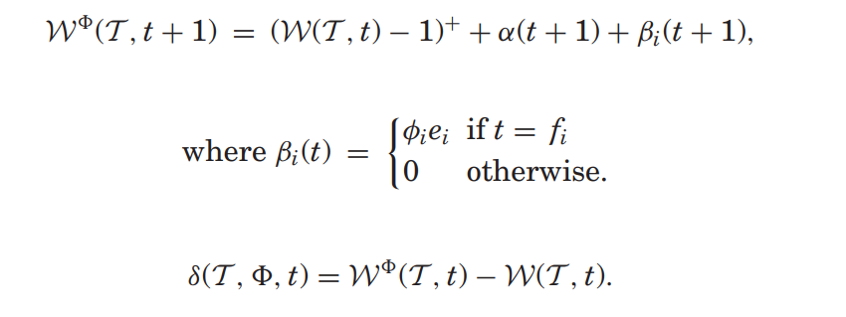
Let f_{i} denote the time when T_{i} completes execution if there are no faults. Now, consider the fault pattern = (φ₁,φ₂,...,φ_{n}), where φ_{i} is the number of faults that strike during execution of T_{i}, i = 1,..., n. Rather than condition this on when these failures actually occur, we “book” them for accounting purposes as if they all arrived at time f_{i} and that each failure of a given task imposes a load equal to the WCET of that task.

Slide 19
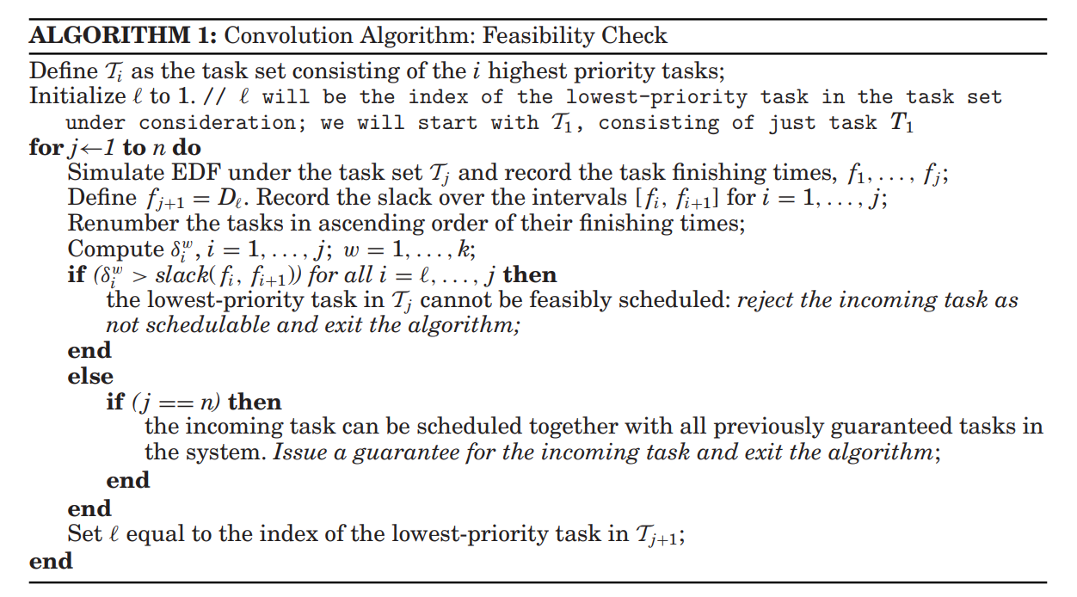
Convolution algorithm

Slide 20
Execution of Periodic Tasks
A is the union of intervals during which the alternatives are scheduled and α_{i} the time when the alternative to task Ti is scheduled to start executing.
Before any primary starts executing, the system checks to see if enough time is available in the schedule to complete it. If not, execution of the primary is abandoned.
If the primary of task T_{i} finishes before αi, its alternative is canceled and its assigned interval within the schedule is removed from A.
If the primary of task T_{i} does not finish before α_{i}, or it is known to have failed before then, all further execution of the primary is abandoned and the alternative starts executing.
Although α_{i} is the point at which a backup for task T_{i} is supposed to start executing, if the processor finds itself idle before then, it can start executing backups early. However, as mentioned previously, outside the set of intervals, A, the backup(s) have lower priority than primary tasks.

Slide 21
Permanent faults
The simplest way to deal with such faults is to have spare processors in the system. When a processor fails, its schedule is switched over to that of the replacement processor:-
We have processors with private rather than shared memory. Then one of two possibilities exist:
Copies of all tasks that this spare processor may have to execute are preloaded in its memory.
Once the system knows which tasks need to be run on the spare processor, those tasks can be loaded into its memory.
Having idle spares usually wastes energy. If all available processors are actively involved in executing the workload, the workload per processor is less.

Slide 22
Periodic Tasks
Task scheduling problem can be broken into two parts:-
task assignment and multiprocessor scheduling.
The first-fit algorithm can be used here. For each task, we identify the first processor on which it can be feasibly assigned. By this assignment, we mean that this task together with the tasks, if any, already assigned to that processor, can all meet their deadlines. The tasks assigned need not be in RM priority order. They could follow some other ordering—for example, we could choose to order the longer tasks (i.e., those with a longer WCET) first or simply pick them at random.

Slide 23
All Periods Equal
All of the tasks are periodic, have the same period, and are released at the same time. The idea is to assign one copy of each task to processors with the tasks being assigned in decreasing order of their execution times. Processors are grouped in pairs, and both processors in a pair are assigned exactly the same tasks. Once the tasks have been assigned, they can be scheduled. The tasks assigned to the same processor are scheduled in decreasing order of execution time.

Slide 24
General Task Periods
All task periods are equal and introduce the fault-tolerant assignment algorithm. All tasks have primary and backup copies associated with them.
Active or Primary Tasks: These are the tasks to be run in the absence of a failure.
Backup Tasks: These will be activated upon a processor failure that affects their corresponding active task.
Passive Backup Tasks: These tasks can be scheduled so that they start executing only after the scheduled completion time of their primary. As a result, they can remain dormant until that primary has failed.
Active Backup Tasks: If the schedule is so tight that we cannot find time to schedule the tasks as passive backups, they must be scheduled as active backups. That is, they must start running even before we know that their primary has failed since there will be no time to execute them to completion if we wait until we know that the primary task has failed.

Slide 25
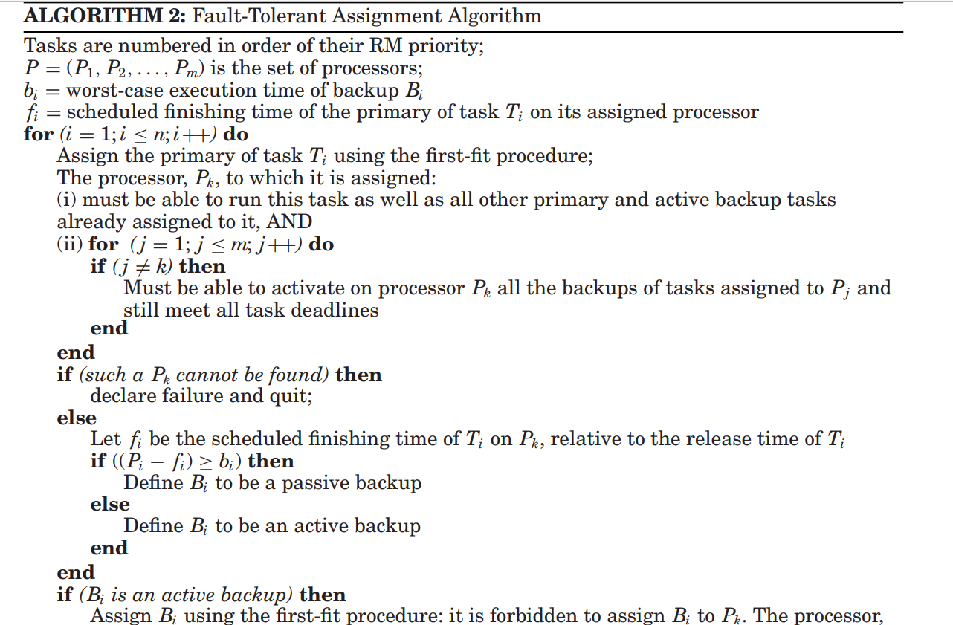
Algorithm

Slide 26
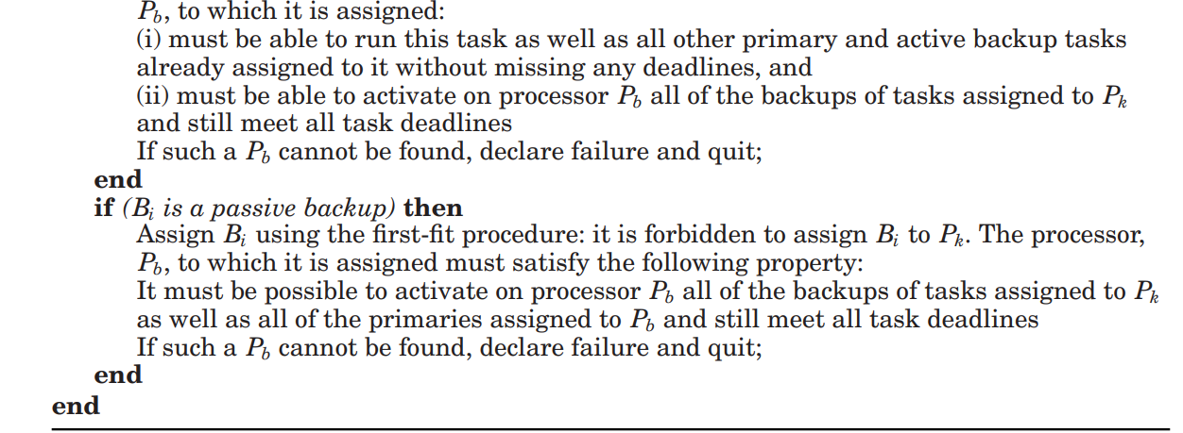

Slide 27
Sporadic and Nonpreemptive Tasks
tasks arrive dynamically
when a task arrives the system determines if it has enough time to guarantee its execution. If so, the task is accepted; if not, the task is rejected and is no longer its responsibility
This starts by scheduling the primary copy of the incoming task by using use a first-fit approach to choose the processor that will be allocated as the primary.
Also we can find a processor that can feasibly schedule this primary, we try to identify a processor that can feasibly schedule its backup.

Slide 28
Dynamic Programming Approach
It is an offline technique, in which multiple schedules are constructed for each processor. The first is the backup schedule, the second a primary schedule, and the rest are the contingency schedules to be invoked upon backup activation.
In the absence of faults, the primary schedule is executed. When a backup needs to be activated, this is done according to the backup schedule, with primary tasks having to give way to the backup’s. Hence they are passive backups.
the dynamic programming approach can use any scheduling algorithm that consists of a task assignment part and a uniprocessor scheduling part.

Slide 29
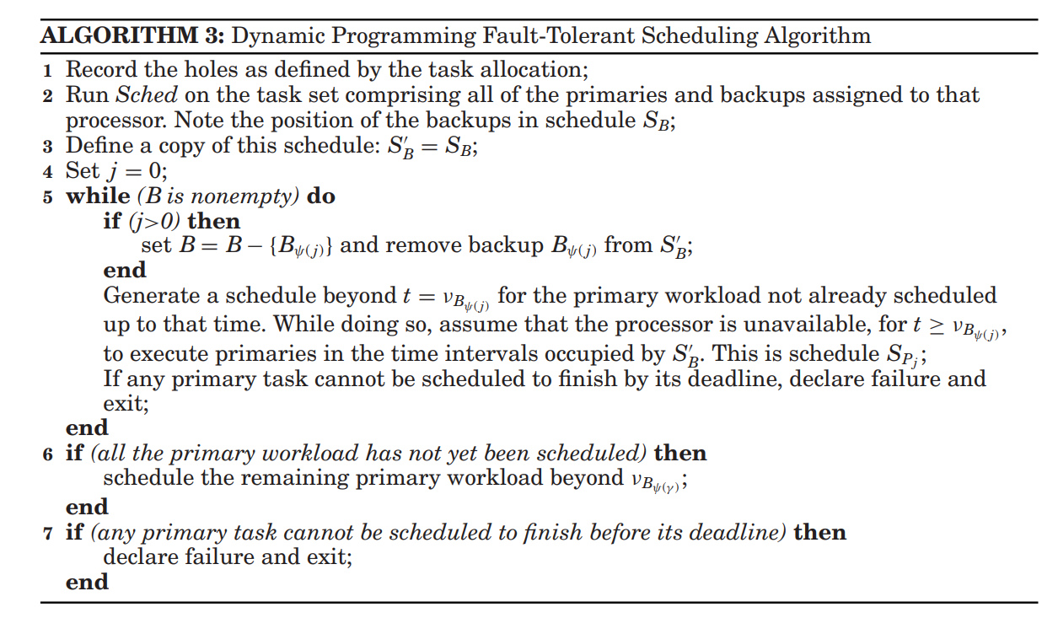
Algorithm

Slide 30
Conclusion
Real-time systems are becoming ever more widely used in life-critical applications, and the need for fault-tolerant scheduling can only grow in the years ahead. In this article, some techniques for fault-tolerant scheduling in homogeneous systems have been outlined. All of these algorithms have one objective: to guarantee that, despite a certain maximum number of faults, the tasks will have enough hardware and time redundancy to meet their deadlines. In a heterogeneous system, tasks can have different execution times on different processors. If nodes are heterogeneous, they are also likely to differ in their failure characteristics, both in the rate with which they fail and also the temporal characteristics of their transient failure.

